Slide 1
Ninth NEBInet
Annual Co-ordinators Review Meeting
Tezpur (Central) University, Tezpur
17-19th January 2017
1

Slide 2

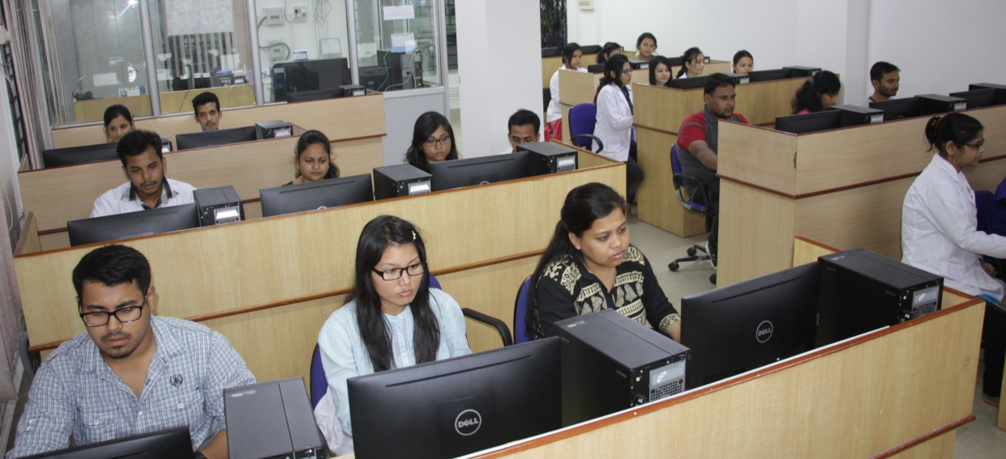
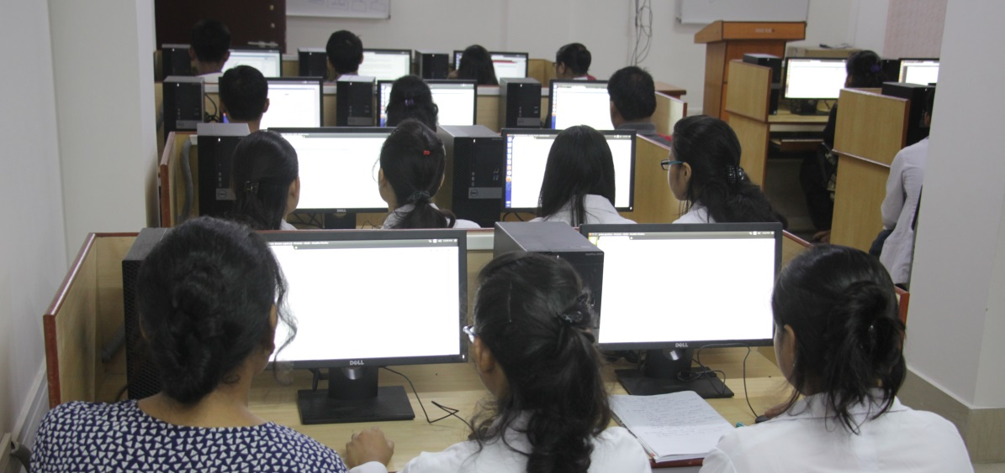
DBT-funded
Bioinformatics Infrastructure Facility
Centre for Biotechnology and Bioinformatics
School of Science and Engineering
Dibrugarh University
Dibrugarh- 786 004
Assam, INDIA
2015-2016
2

Slide 3
OBJECTIVES
To enable the Masters and PhD students of the University in developing perceptions about modern Biology in post genomic scenario through hands on experiences.
To impart the ability to handle high end Bioinformatics tools to the students.
To provide a platform to the research students in Biotechnology and Bioinformatics, Life science, Pharmaceutical Sciences, Chemistry, Computer Science, Statistics and Mathematics of the University for interdisciplinary and multidisciplinary researches in fundamental and applied areas of Biological Sciences
To acquaint the teachers and research students and Scientists of the affiliated colleges of the University and of other institutes with contemporary developments in Bioinformatics through organization of Training Programmes and workshops to facilitate effective teaching and research in modern Biology
3

Slide 4
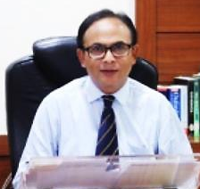
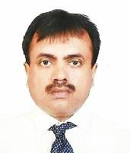
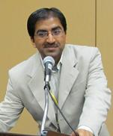
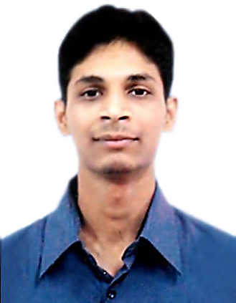
DBT-BIF Members
Prof. Alak Kumar Buragohain, Hon’ble Vice-Chancellor, Dibrugarh University Area of Interest: Molecular evolution, Molecular Biology & Computational Biology
Dr. Bibhuti B. Kakoti, Chairperson and Coordinator Area of Interest: Computational Biology, CADD & Pharmacology
Vishwa Jyoti Baruah, Assistant Professor and Co-coordinator Area of Interest: Computational Biology & Molecular evolution

Slide 5
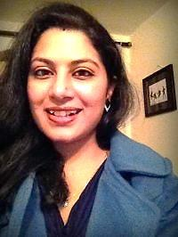
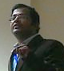
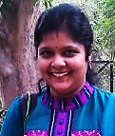
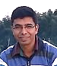
DBT-BIF members (Contd.)
Mrs. Amrita Kashyap Chaliha, Assistant Professor Area of Interest: Drug discovery & Chemo-informatics
Mr. Subrata Sinha, Assistant Professor Area of Interest: Bio-Programming
Mrs. Surabhi Johari, Assistant Professor Area of Interest: Computational Biophysics & CADD
Dr. Diganta Sarma, Associate Professor (Chemistry) Area of Interest: Chemo-informatics, CADD & Green Chemistry

Slide 6
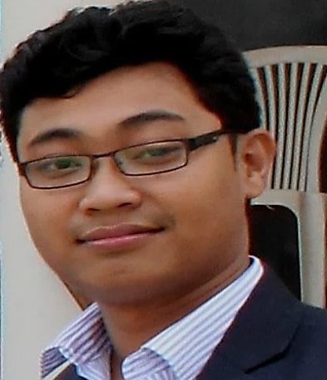
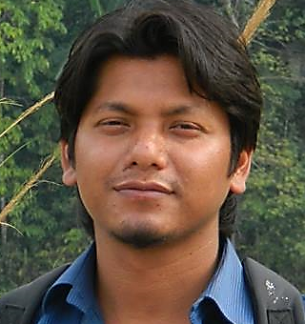
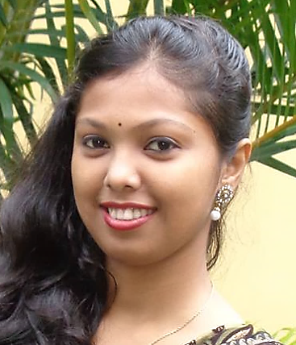
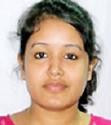
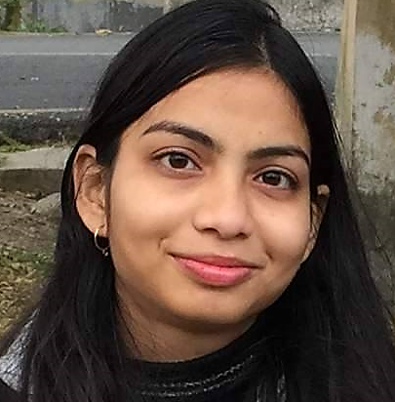
DBT-BIF MANPOWER
Mr. Dhrubajyoti Gogoi, Research Associate. Area of Interest: Computer Aided Drug Designing
Mr. Nabajyoti Gogoi, Traineeship Area of Interest: Chemo-informatics & Medicinal Plants
Mrs. Purnima Das, Traineeship Area of Interest: Chemo-informatics
Ms. Priyanka Hatimata, Studentship Area of Interest: Chemo-informatics
Ms. Anisha Shah, Studentship Area of Interest: Computational Biology

Slide 7
DBT-BIF Facility
Sl. No. | Particular | Qty. (nos.)
1. | Server (Dell PowerEdge 2900) | 2
2 | Desktop PC with Win/Linux OS (Dell Optiplex Series) | 23*
3 | Printer (HP LaserJet Series) | 2
4 | Online UPS (10KVA) | 1
5 | Overhead Projector | 1
* Procured/upgraded using Dibrugarh University fund
Softwares and Networking
Operating System and application software: Microsoft Windows 2008 Server; Microsoft Windows 2007, 2008; Ubuntu 16.04 (Linux); Microsoft Office 2010 Professional Edition; Quick Heal Total Security 2011
Scientific software packages: Discovery Studio 4.5*; Free academic software for protein structure prediction, gene prediction, phylogenetic analysis, data analysis/modelling, docking softwares; Molecular visualization tools and molecular modelling softwares are available.
Networking: Internet connectivity is provided throughout the institute with BSNL 1 gbps NKN connectivity and a BSNL 1 mbps Leased Line Link (in Centre). Wireless LAN has also been set-up to extend the LAN connectivity to laptop users in the Centre.

Slide 8
Activities done in the year under review
Seminar/training and programs
1 | Important Methodologies in Genomics and Proteomics Research | September 22-27, 2016 (6-day Workshop) | 20 participants (MSc students, PhD Scholars, faculty members and College teachers)
Research activities
1 | Molecular evolution Factors affecting selection of optimal codons in bacteria Computational approach in understanding CUB in eukaryotes
2 | Computer Aided Drug Design (CADD) Novel drug design and discovery against Mycobacteria spp. using vital proteins in metabolic pathway as targets. Novel drug discovery for cancer therapeutics
Facilities Created in 2015-16
15 Desktops were upgraded to Intel Core i3 x64-bit processors (Model Dell Optiplex) 8 additional Intel Core x64-bit processors based Computers (Model Dell Optiplex) were purchased Wi-fi facility was installed to extend the internet facility to DBT- BIF, Staff office, Library, Molecular biology lab and seminar hall

Slide 9
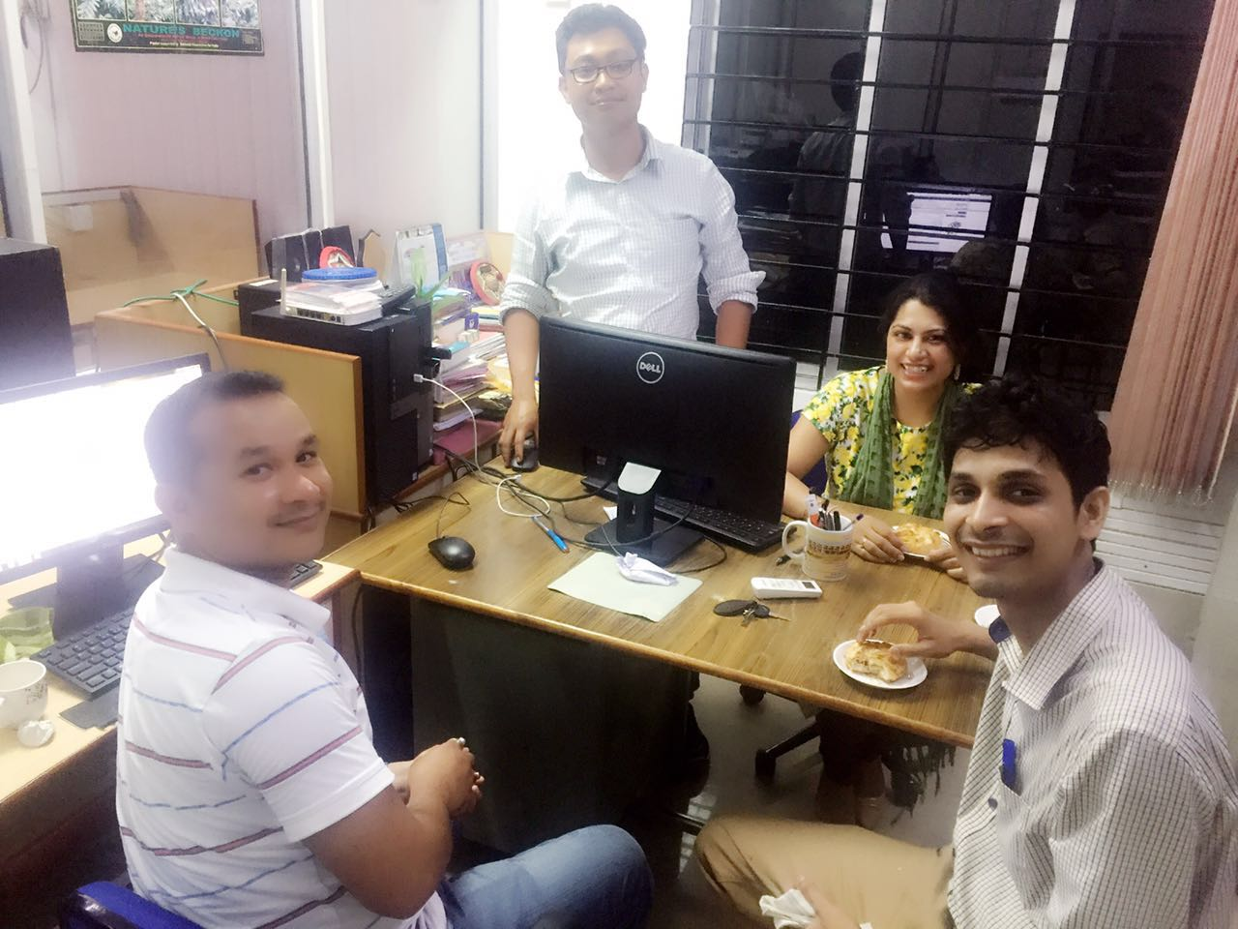
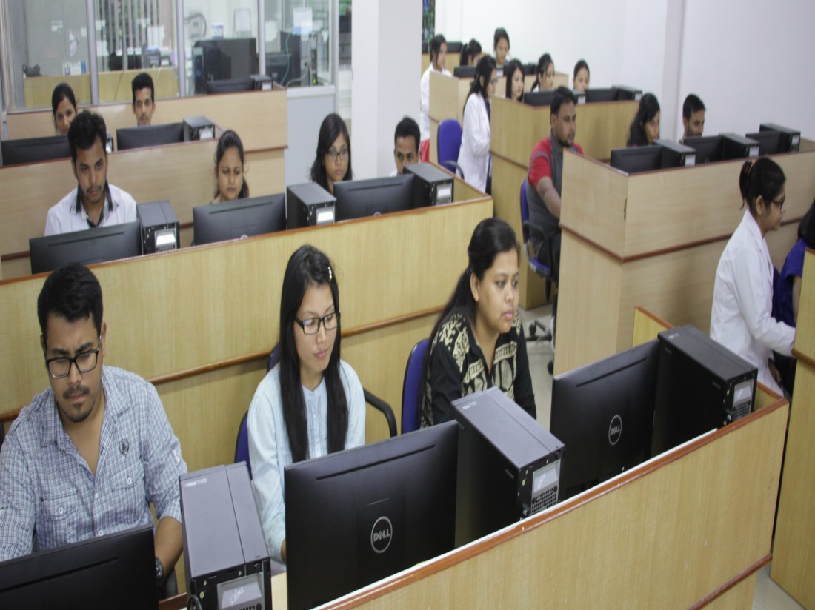
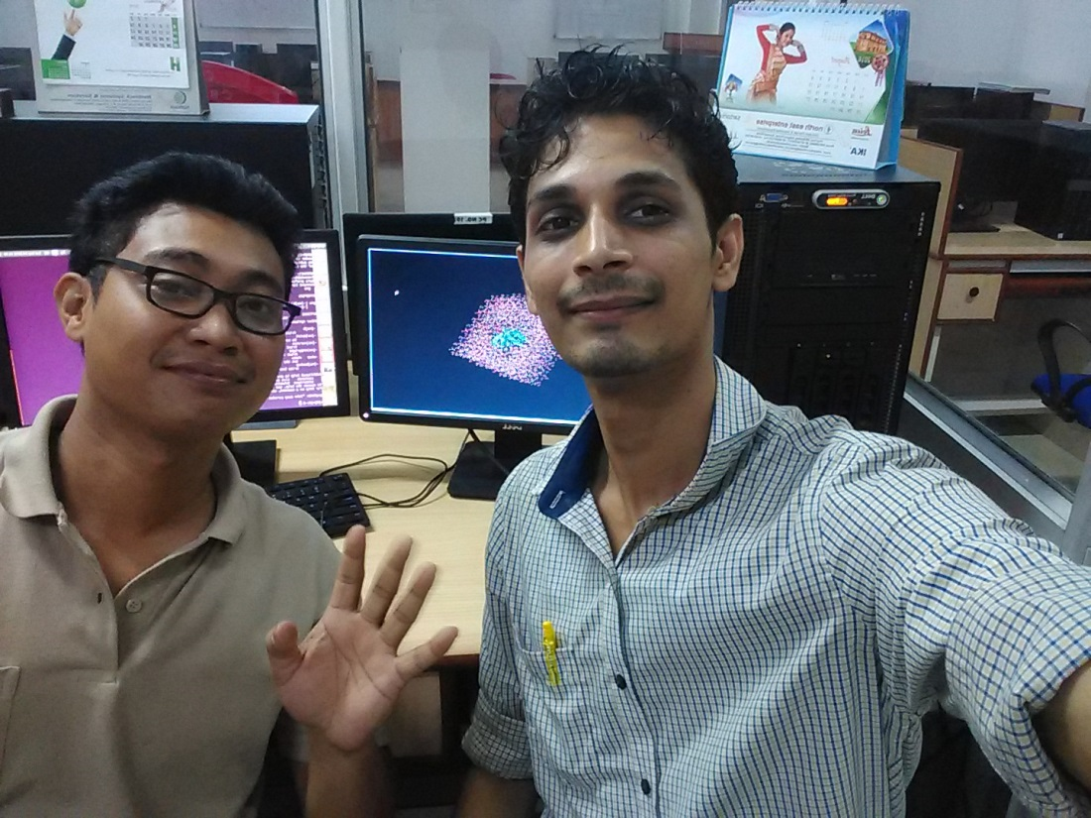
Research Activities in 2016
9

Slide 10
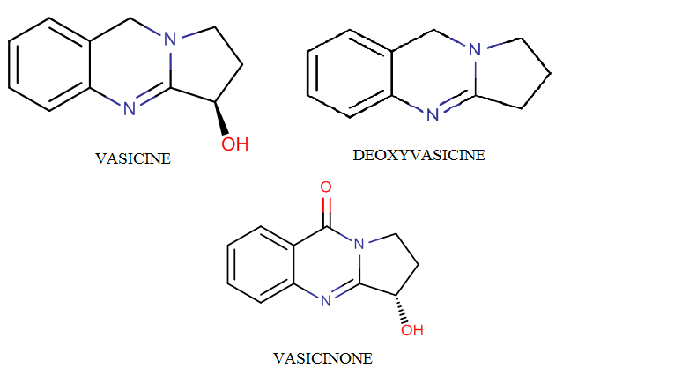
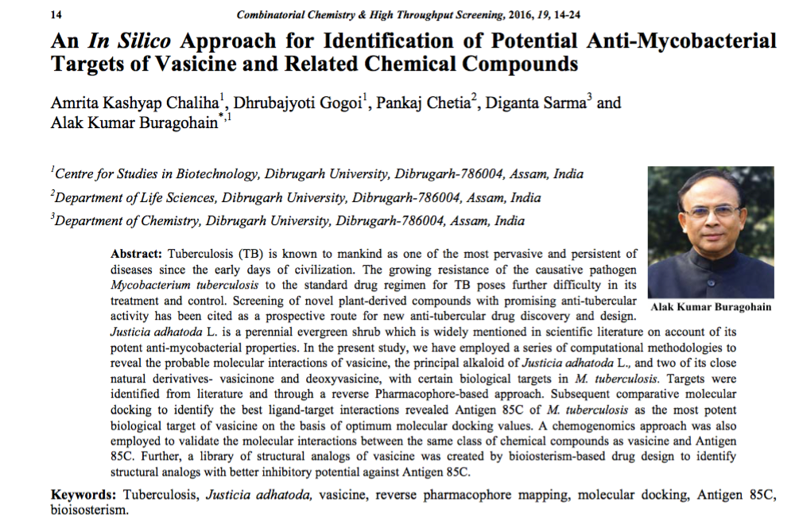
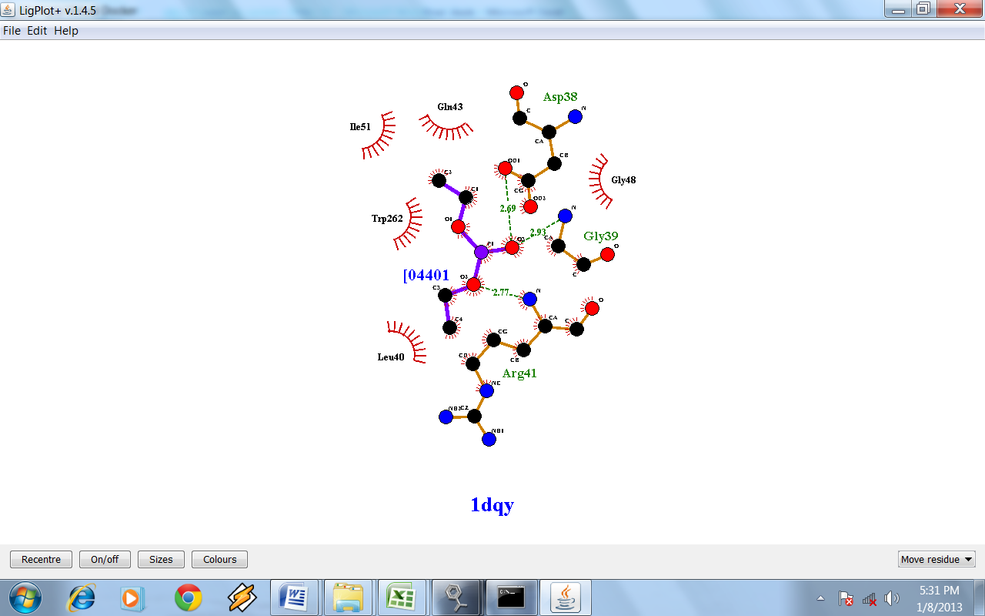
IDENTIFICATION OF POTENTIAL DRUG TARGETS OF VASICINE AND ITS ANALOGUES USING A COMPUTATIONAL APPROACH
Protein target identification of Vasicine and its derivatives using computational approach
2. Structural optimization of Vasicine
3. Synthesis of novel Vasicine analogues
Paper published in the Journal of Combinatorial Chemistry and High throughput Screening, Bentham Science Pub. (SCI Impact factor 1.2)
10

Slide 11
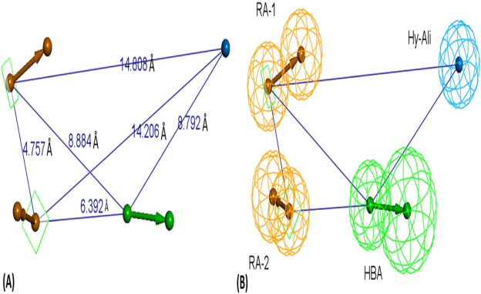
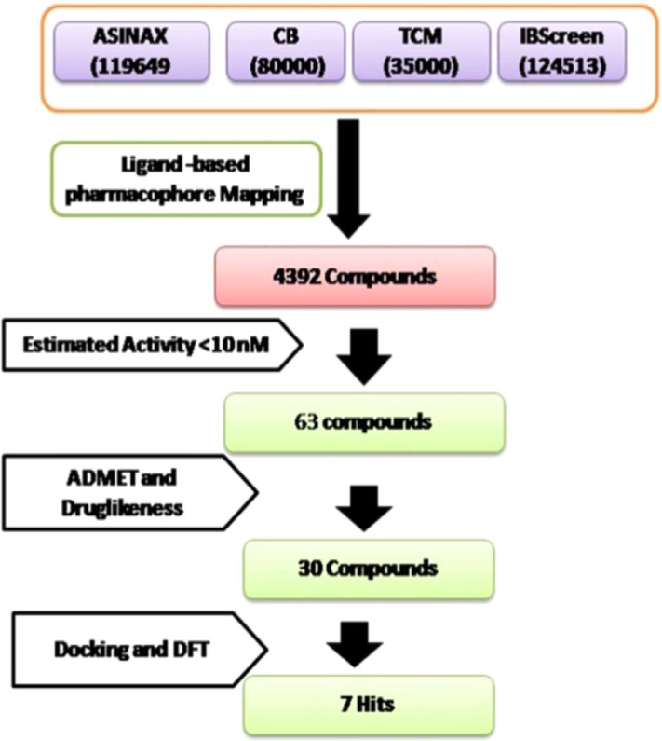
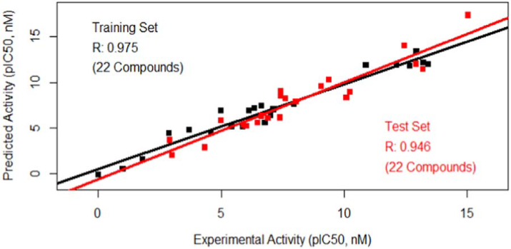
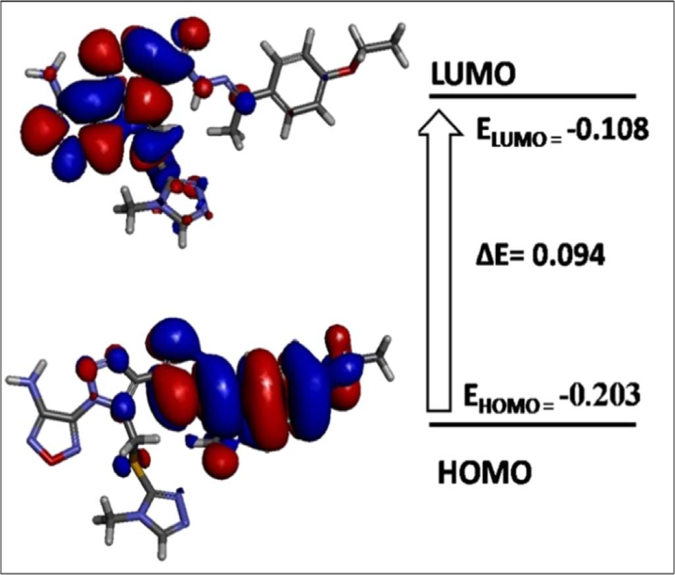
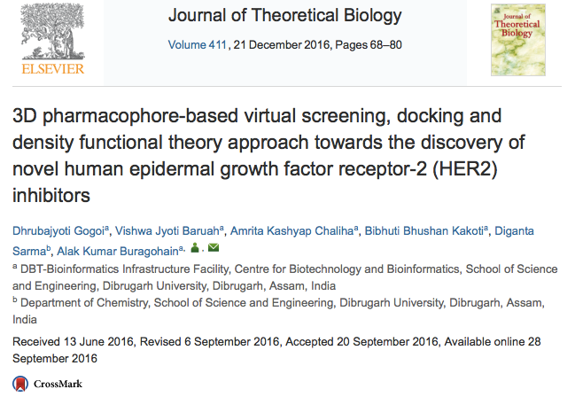
DISCOVERY OF NOVEL HUMAN EPIDERMAL GROWTH FACTOR RECEPTOR-2 (HER2) INHIBITORS THROUGH CONTEMPORARY in silico APPROACHES

Slide 12
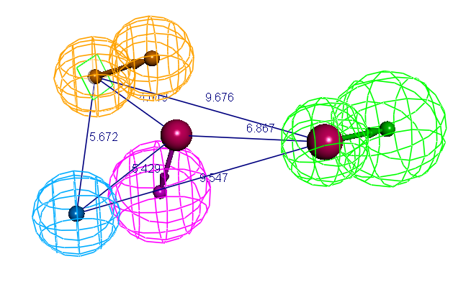
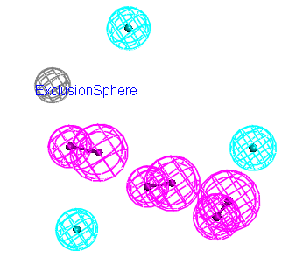
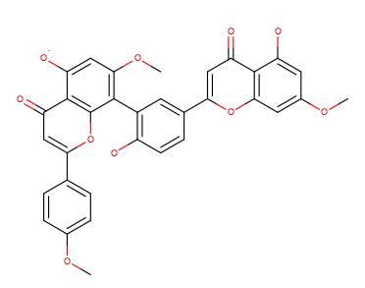
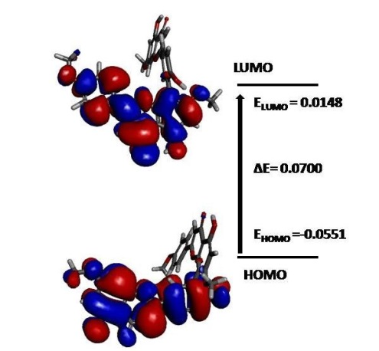
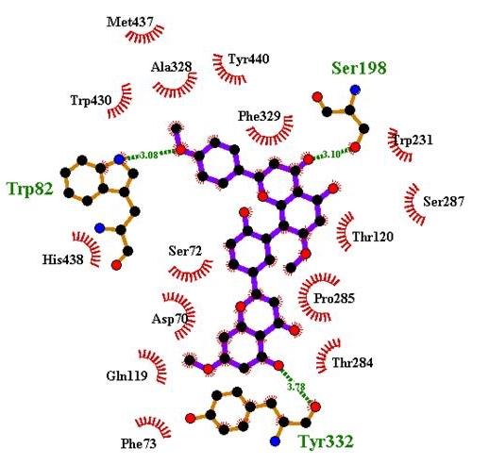
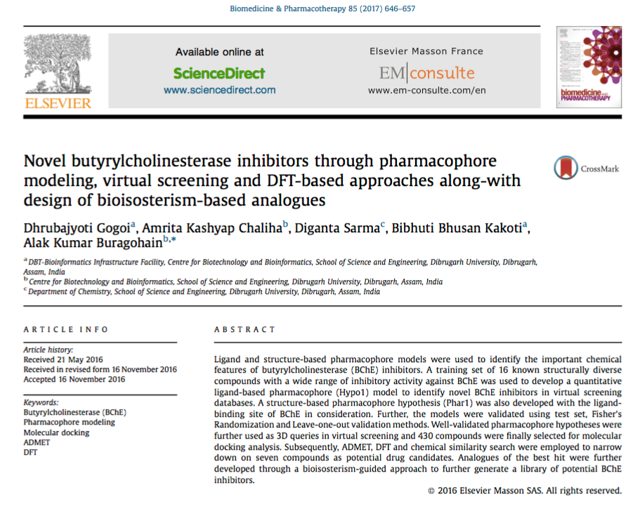
Pharmacophore Modeling, Virtual Screening, DFT Analysis and Bioisosterism based Analogues Designing towards the Discovery of Novel Butyrylcholinesterase Inhibitors
Ligand-based and structure-based pharmacophore modeling were used to identify the important chemical features of Butyrylcholinesterase (BChE) inhibitors.
A training set of 16 known structurally diverse compounds with wide range of inhibitory activity against BChE were used to develop a quantitative Ligand-based pharmacophore (Hypo1) model in order to identify novel BChE inhibitors in the virtual screening database.
A structure-based pharmacophore hypothesis (Phar1) was also developed based on the ligand binding site of BChE. Further, the models were validated using a Test set, Fisher’s randomization and Leve-one-out validation methods. Hypo1 consisting of two Hydrogen Bond Acceptor (HBA) feature, one Hydrogen Bond Donor (HBD), one Hydrophobic-Aliphatic (Hy-Ali) feature and one Ring Aromatic (RA) feature. Correlation coefficient (r), Root mean square (RMS) deviation and total cost values of Hyp1 are 0.968, 1.066 and 77.179 respectively.
Phar1 consisting of six pharmacophoric features and validated using a Test set of known BChE compounds. Well validated pharmacophore hypothesis were further used as 3D query in the virtual screening and 530 compounds were culled down for Docking Studies.
ADMET Studies, DFT Calculation, Chemical Similarity Search and Analogues Development were suggested 6 novel compounds and the 6 analogues of best hit as potential BChE inhibitors.
Hypothesis 1
Hypothesis 2
VIRTUAL SCREEING
12

Slide 13
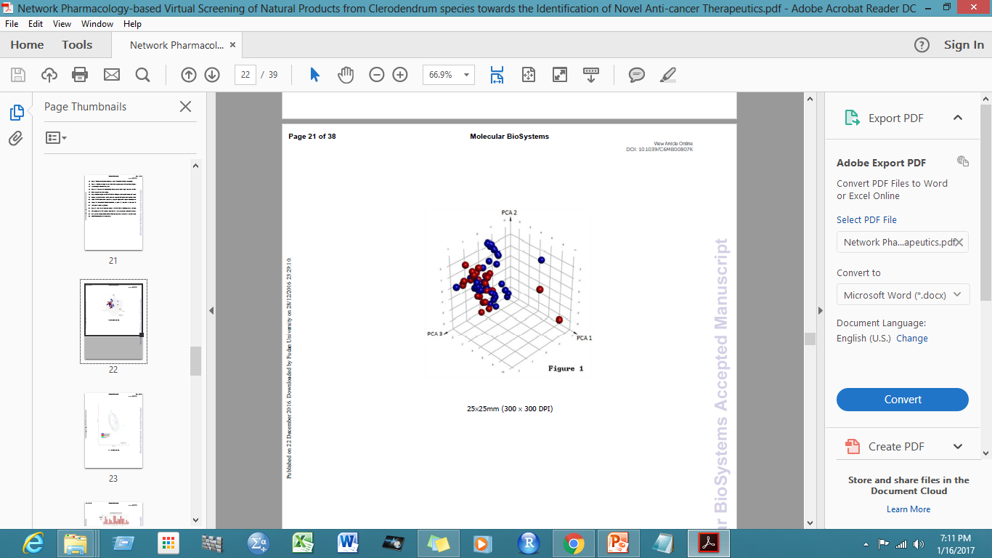
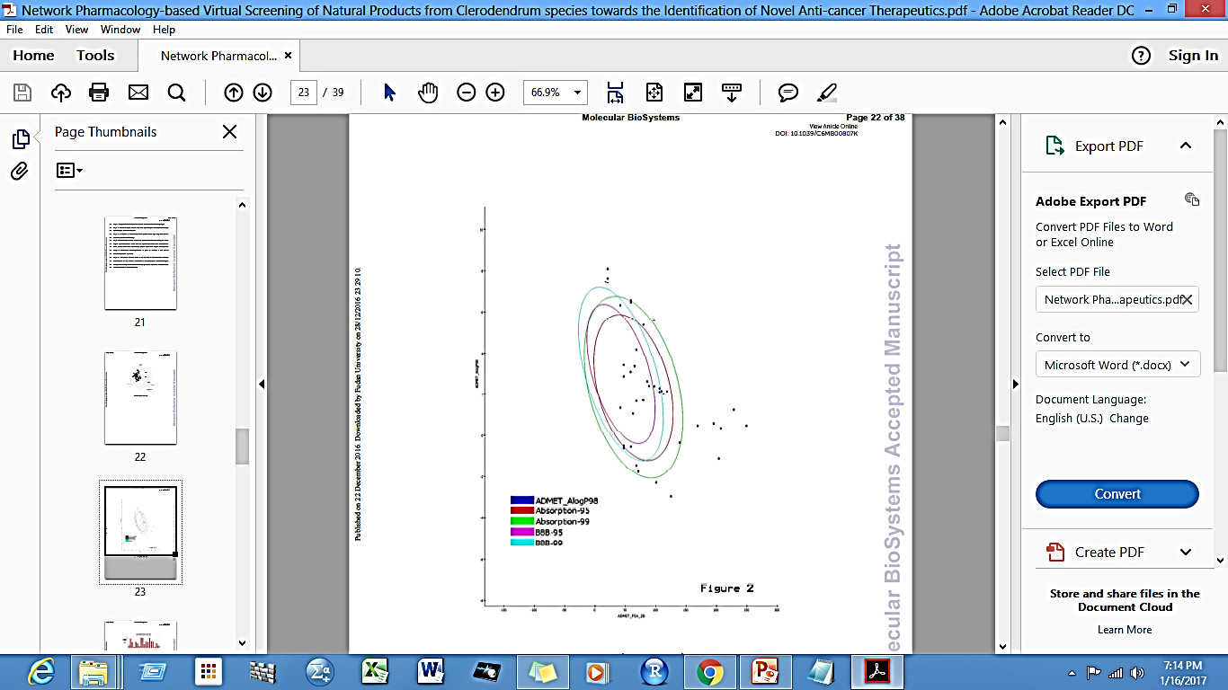
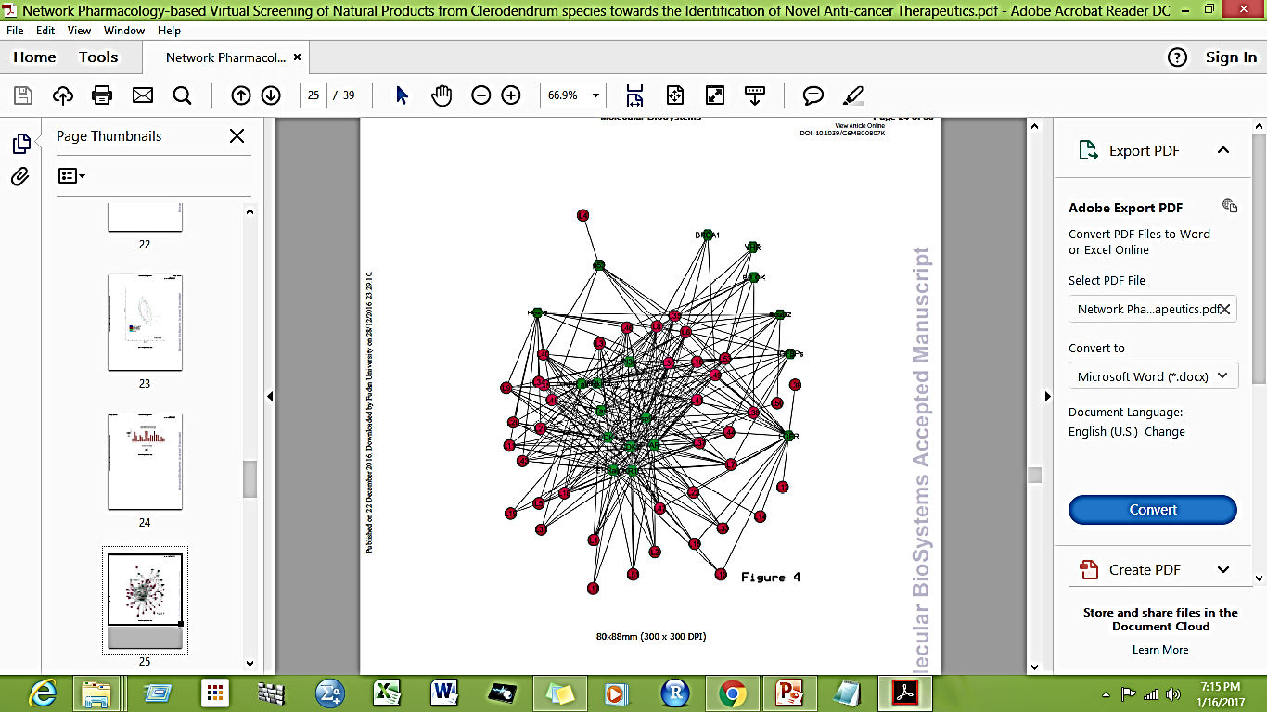
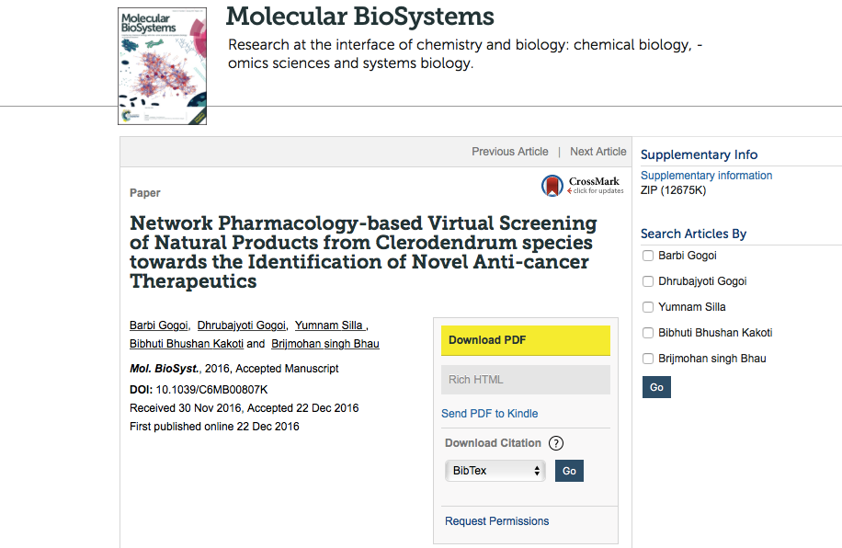
NETWORK BASED APPROACHES FOR IDENTIFICATION OF NOVEL ANTI CANCER THERAPUTICS
13

Slide 14
Summary of Research Activities in 2016
Papers accepted or in-press
Gogoi D, Baruah VJ, Chaliha AK, Kakoti BB, Sarma D, Buragohain AK. 3D pharmacophore-based virtual screening, docking and density functional theory approach towards the discovery of novel human epidermal growth factor receptor-2 (HER2) inhibitors. J Theor Biol. 2016; 411:68-80. IF-2.049
B. Gogoi, D. Gogoi, Y. Silla , B. B. Kakoti and B. S. Bhau, Network Pharmacology-based Virtual Screening of Natural Products from Clerodendrum species towards the Identification of Novel Anti-cancer Therapeutics. Mol BioSys. 2016, DOI: 10.1039/C6MB00807K, IF-2.829
Chaliha AK, Gogoi D, Chetia P, Sarma D, Buragohain AK. An In Silico Approach for Identification of Potential Anti-Mycobacterial Targets of Vasicine and Related Chemical Compounds. Comb Chem High Throughput Screen. 2016;19(1):14-24. IF-1.041
Gogoi D, Chaliha AK, Sarma D, Kakoti BB, Buragohain AK. Novel butyrylcholinesterase inhibitors through pharmacophore modeling, virtual screening and DFT-based approaches along-with design of bioisosterism-based analogues. Biomed Pharmacother 2016. Epub 2016/12/03. IF-2.326
Other papers in communication
In editing and finalizing process: 1 no. | With the editor: 1 no.
With the reviewer: 3 nos. | Under advance revision process: 2 nos.

Slide 15
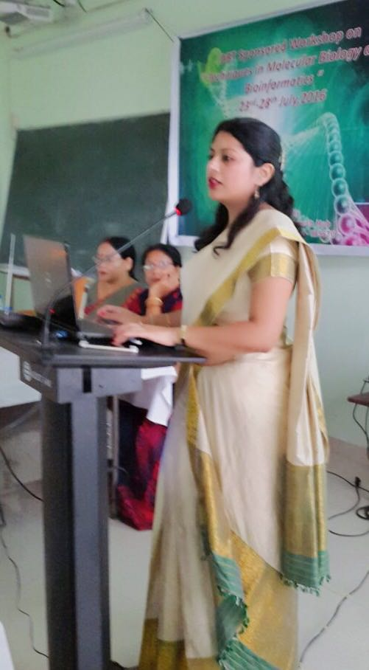
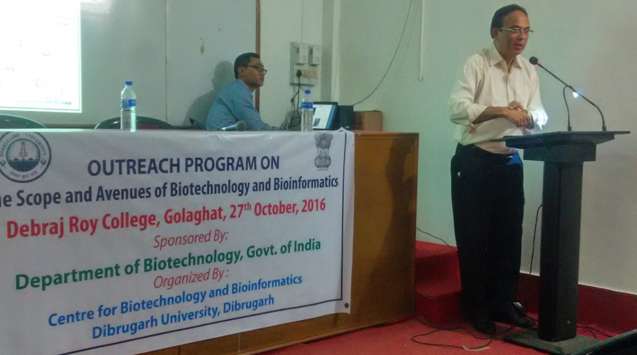
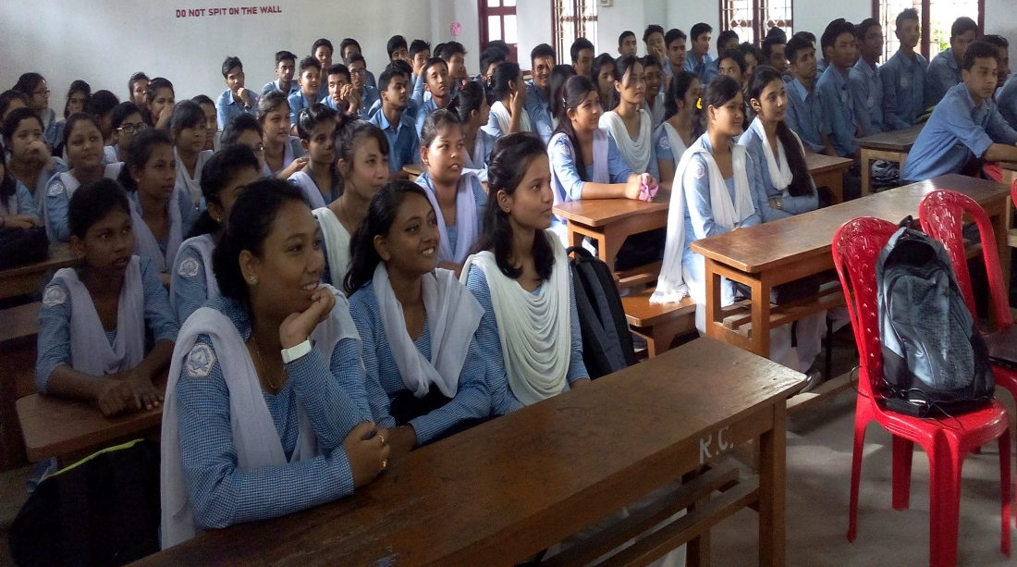
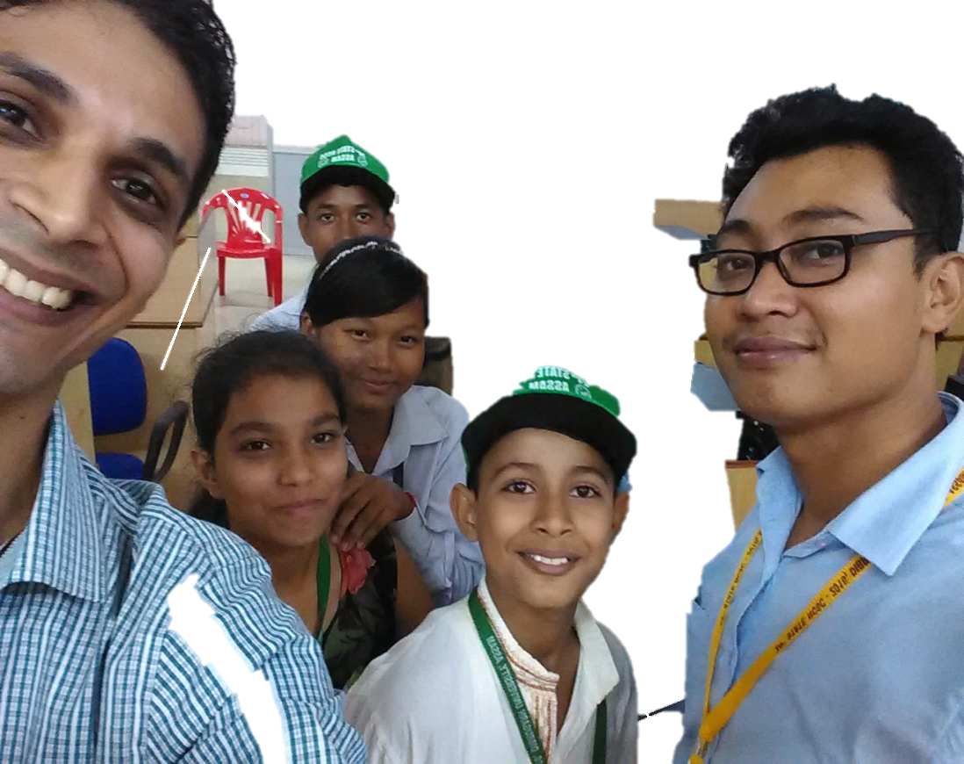
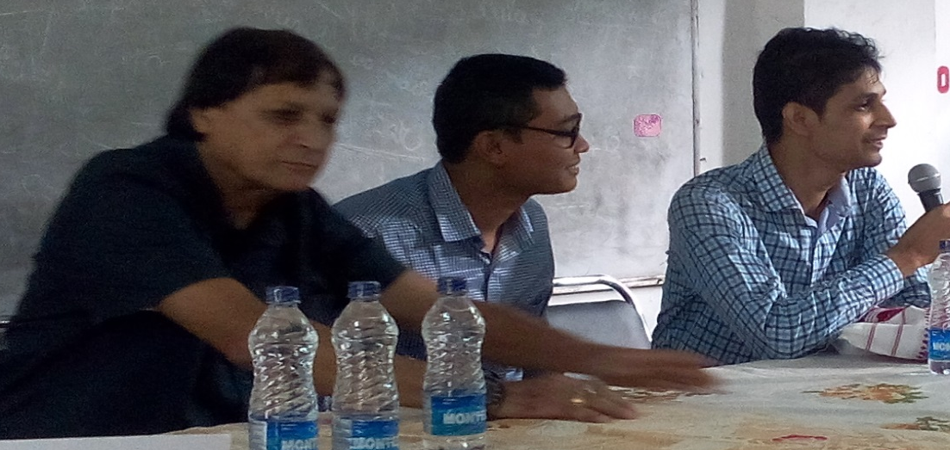
Outreach Activities in 2016
15

Slide 16
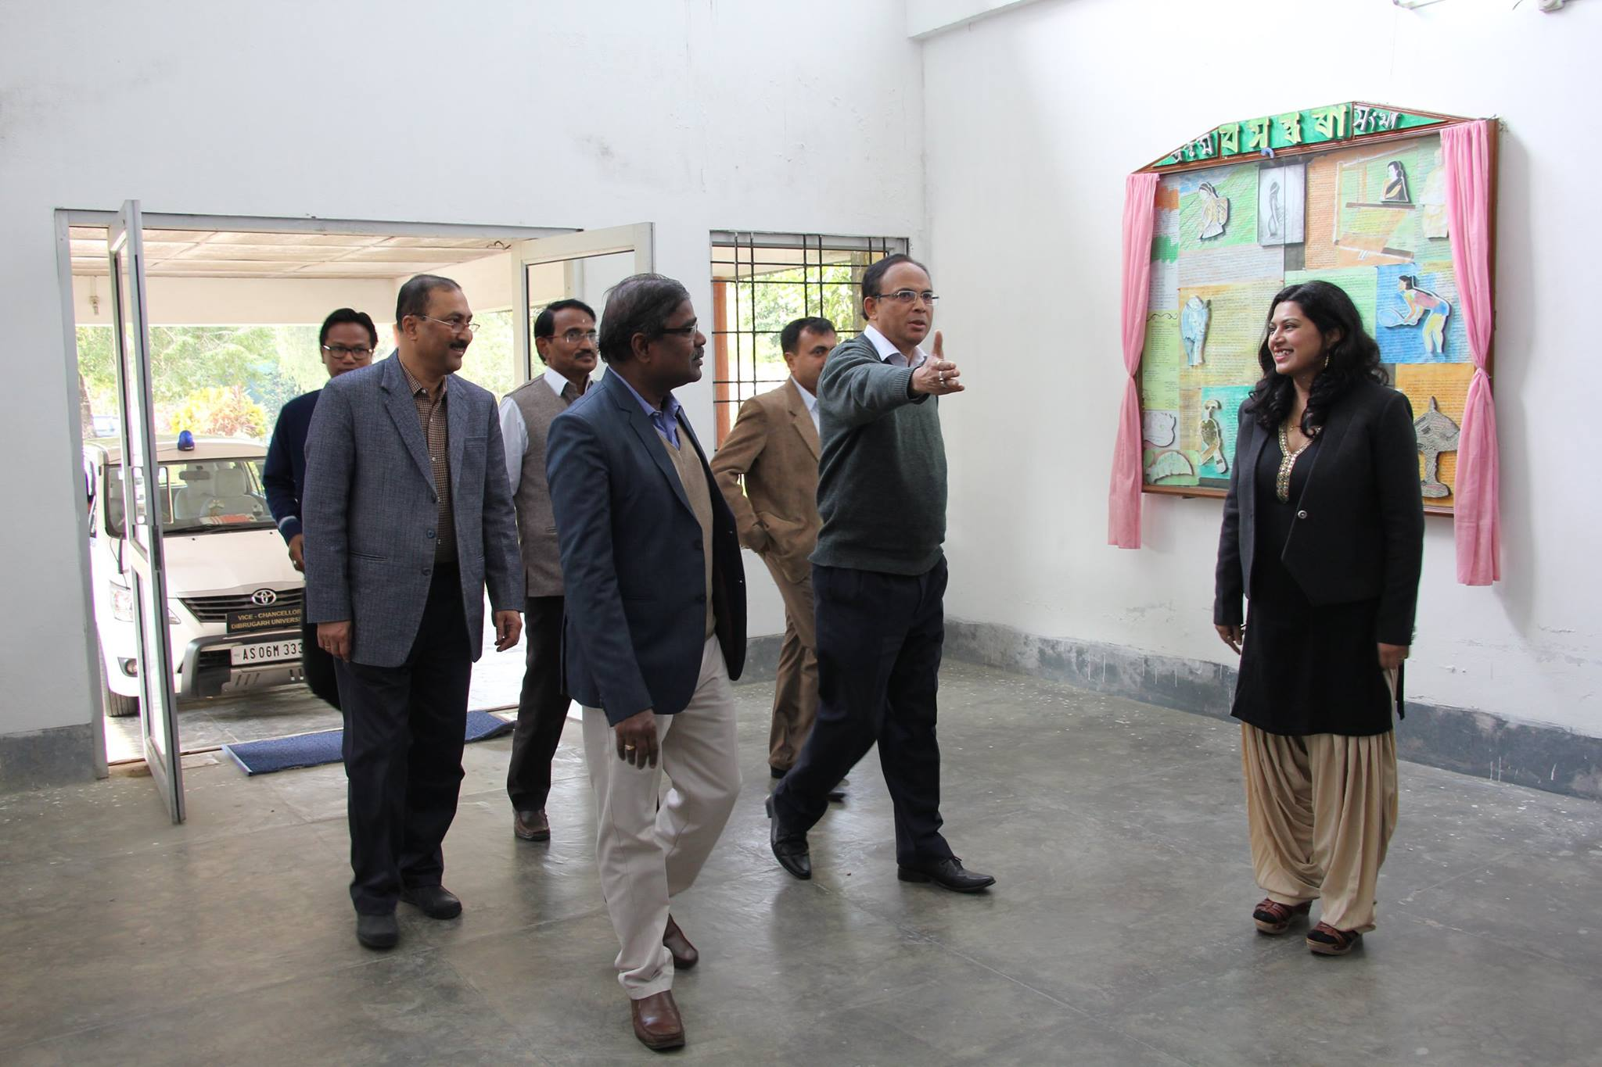
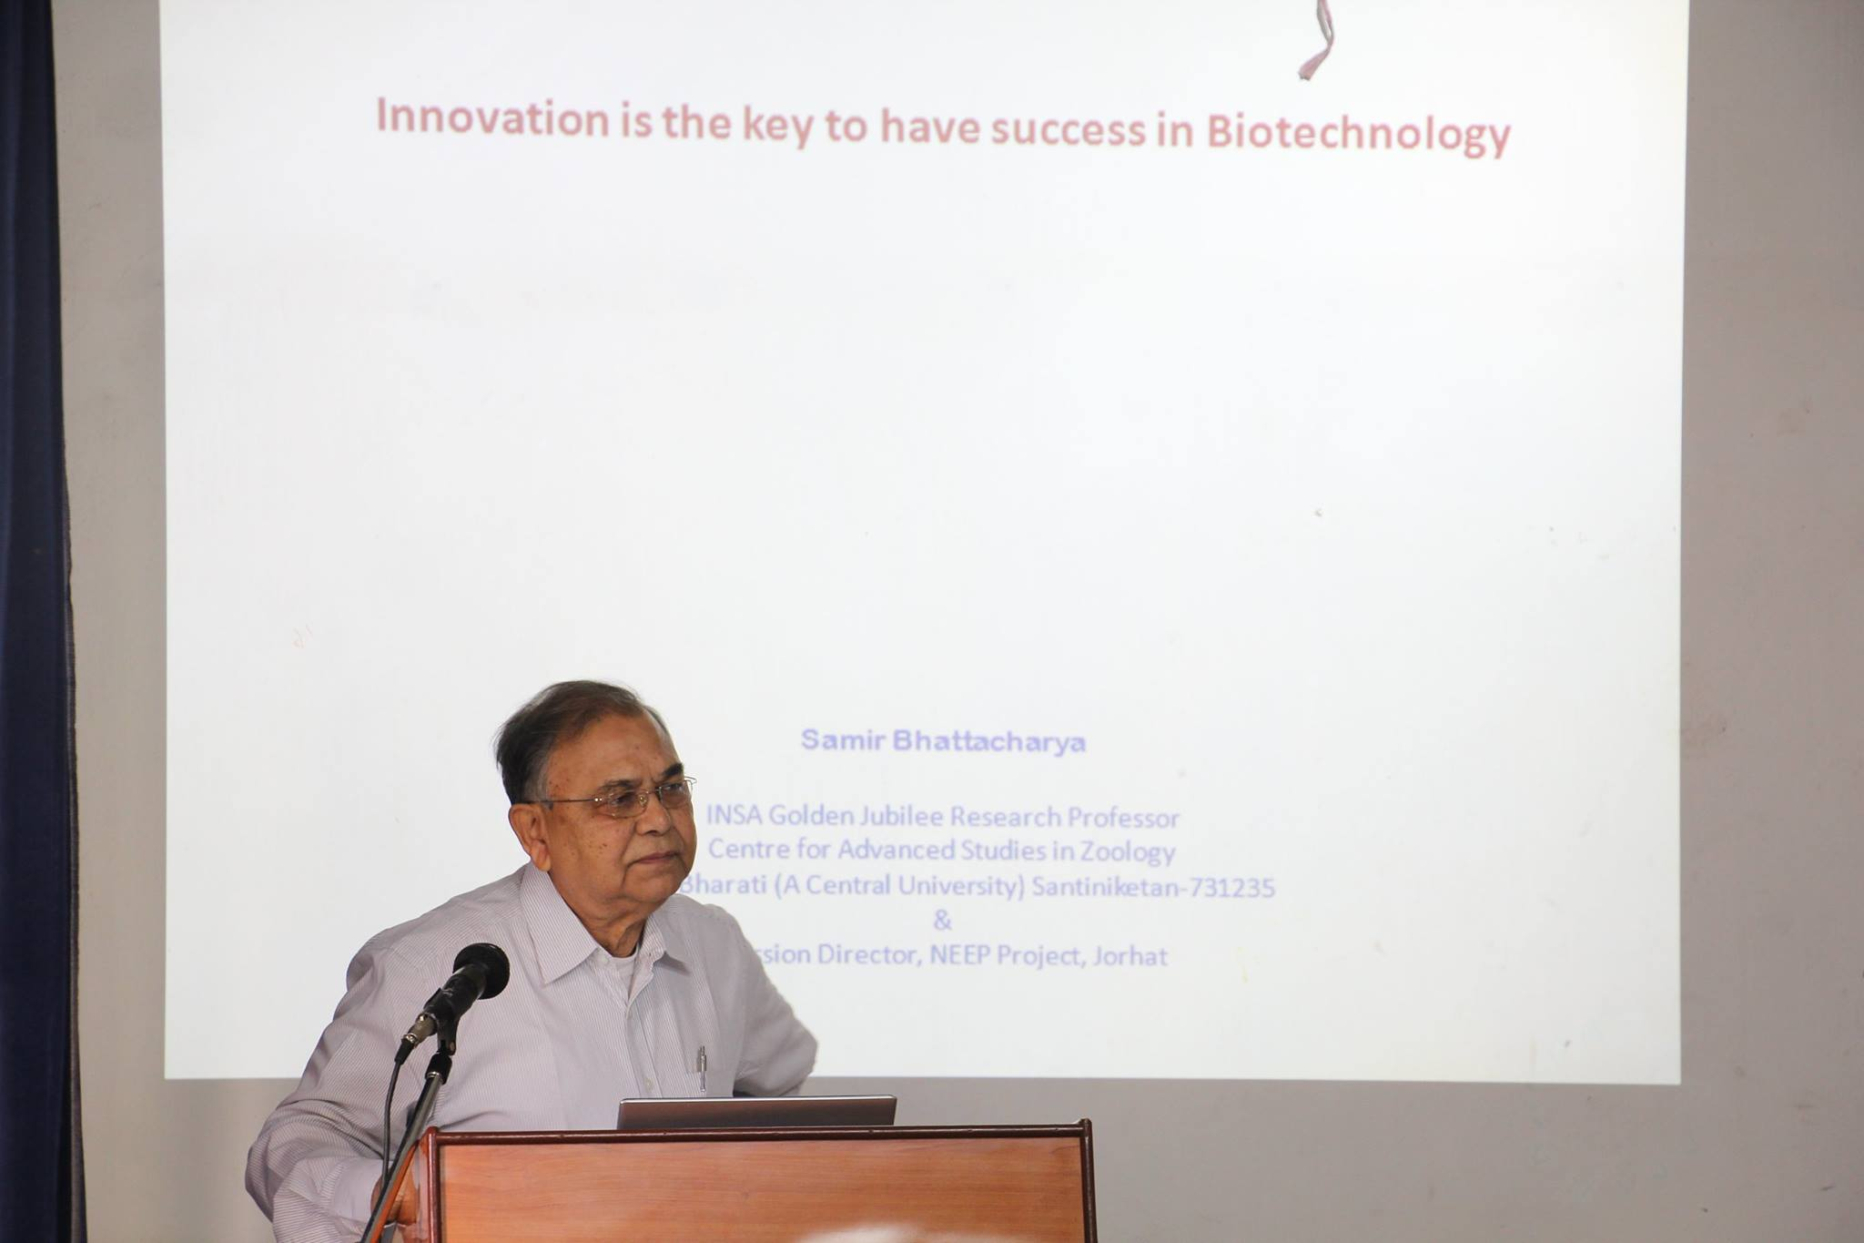
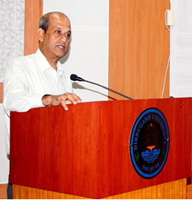
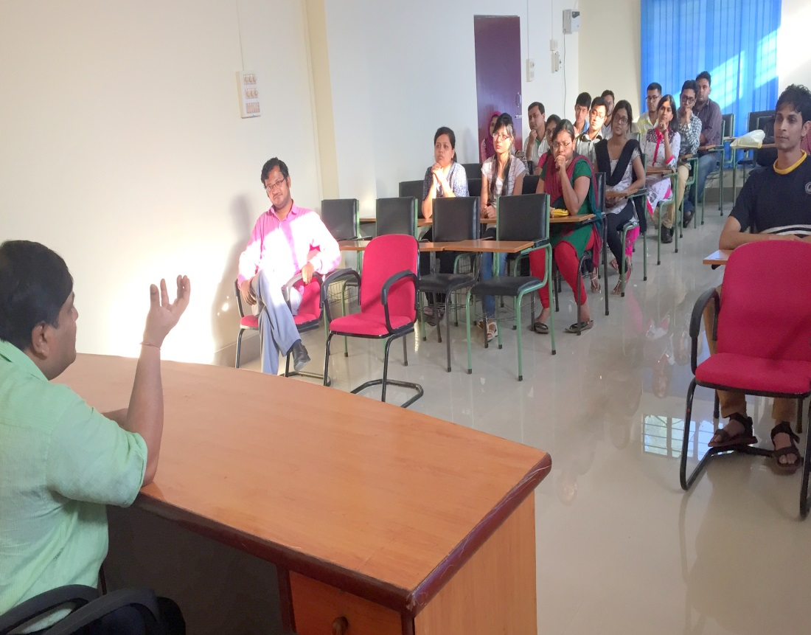
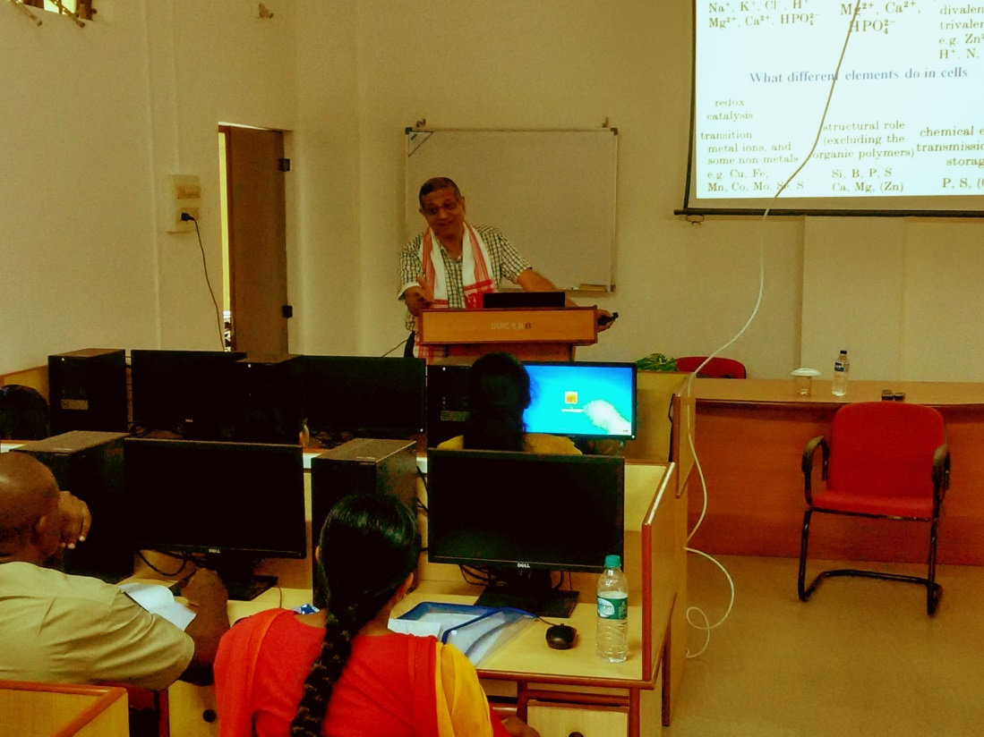
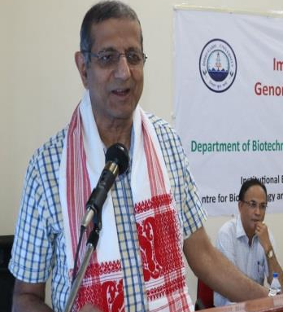
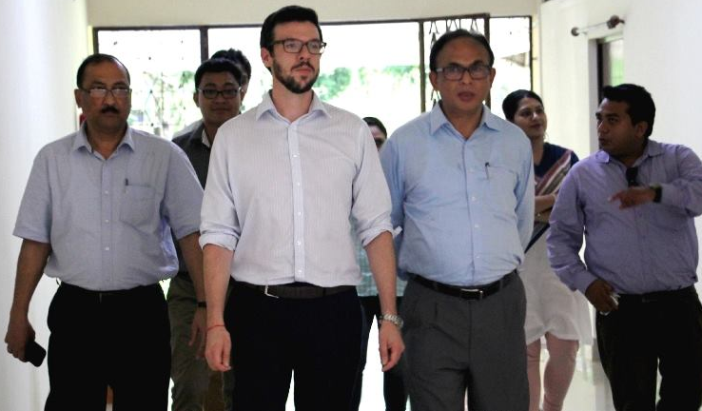
Platform for exposure
16

Slide 17
Future Plan
Seminar-cum-training programs (Tentative)
1 | Workshop on Quantitative Structure Activity Relationship Analysis in Drug Discovery Research | September 22-27, 2017 (6-day Workshop) | 20-25 participants (MSc students, PhD Scholars, faculty members and College teachers)
Research activities
1 | Computer aided drug design Identification of novel targets against Tuberculosis and cancer therapeutics Drug discovery against novel Tuberculosis and cancer targets. Generation of hypothesis and Validation of in silico screened molecules
2 | Molecular evolution: Factors affecting selection of optimal codons in prokaryotes Computational approach in understanding CUB in eukaryotes and viruses
Facilities to be Created in 2016-17
10 additional Intel Core x64-bit processors based Computers to be purchased for dedicated research work Wi-fi facility to be extended to entire centre

Slide 18
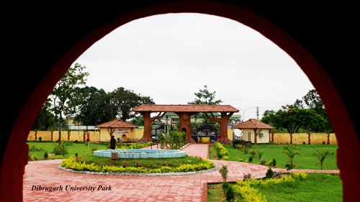
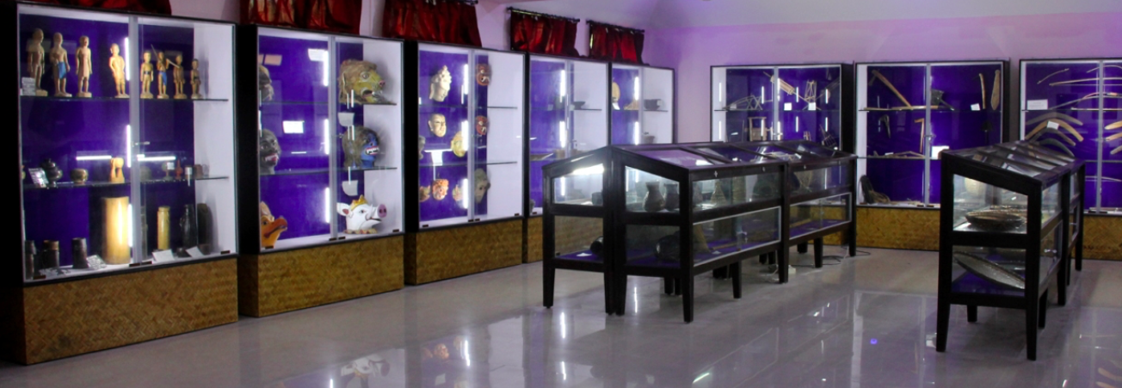
A Glance at Dibrugarh University for a possible NEBINet meeting

Slide 19





Dibrugarh University Guest House

Slide 20





Dibrugarh University Conference Hall

Slide 21



Centre for Biotechnology and Bioinformatics

Slide 22




DBT-BIF Facility

Slide 23
Acknowledgement
Department of Biotechnology, Government of India
Dibrugarh University Administration
Tezpur (Central) University for the hospitality extended towards our participation in the 9th NEBInet Annual Co-ordinators Review Meeting
23

Slide 24

Thank You

